Slide 1

Python CRASH COURSE
Prepared by: Kazi Mushfik Muttakin and Ben Pele

Slide 2
WELCOME!
We utilize Python for our Reward functions.
This session is to help you Learn how to Code in Python, even if you are a complete beginner!
Notes:
We will be using Python for programming our reward functions to move the car around the track
However, for those not well versed in coding, fear not! For this session will be covering everything you need to know about Python to kick start your programming abilities!

Slide 3
01
What is Python?

Slide 4
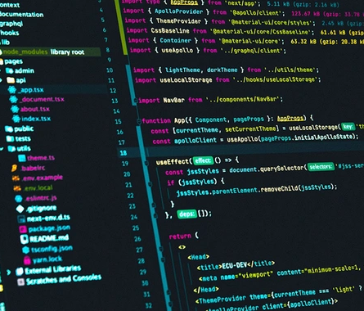
What is python?
High level programming language capable of general-purpose use
Developer and user friendly, high readability
Great for beginners
Technical details:
Dynamically typed
Garbage collected
Supports structured, OOP, and functional programming
Notes:
Python is a high-level language that is used for general purpose programming, such as making applications, scripts, or building entire databases and even Operating Systems out of it. Its usability in almost any situation is one of the reasons it is so highly regarded.
Another reason as to why python is praised by many is the fact that it is high-level, meaning higher readability. High level programming languages mean they are close to how us humans talk and write, so it is easy to understand code and very welcoming to beginners.
Other details of Python which makes it desirable is the fact that it is dynamically typed (meaning variables are compiled at runtime, no need to worry what kind of variables it is), and it has auto garbage collection (wasted memory is cleaned and can be utilized for something else).
It also features different programming paradigms, such as structured, object oriented and functional programming, so it has high versatility in terms of usage.
In other words, it is one of the best go to and starting programming languages out there.

Slide 5
02
Time to Learn Python
Notes:
And that is about all you need to know, time to go into the actual programming portion!
Everyone should have access to the HTML files or Jupyter Notebook files we will be using to go over the python files.

Slide 6
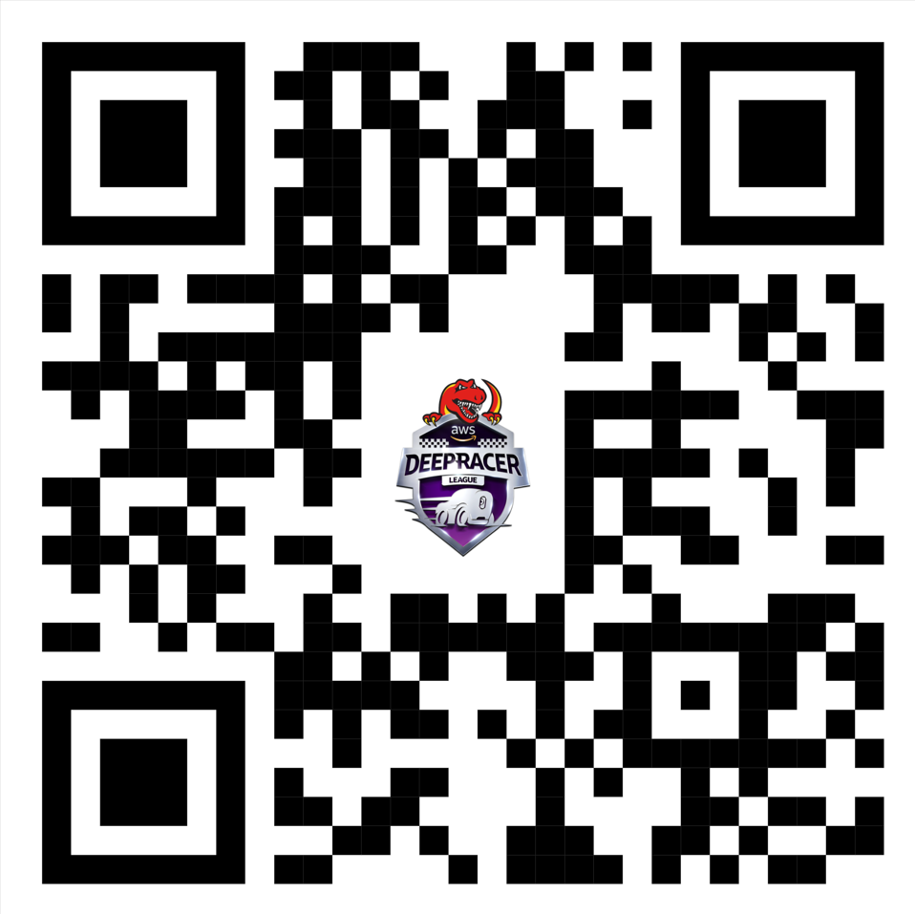
Where to get the notes (Online Repo)
Scan the QR code or head to: https://peen.ca/_xn8y

Slide 7
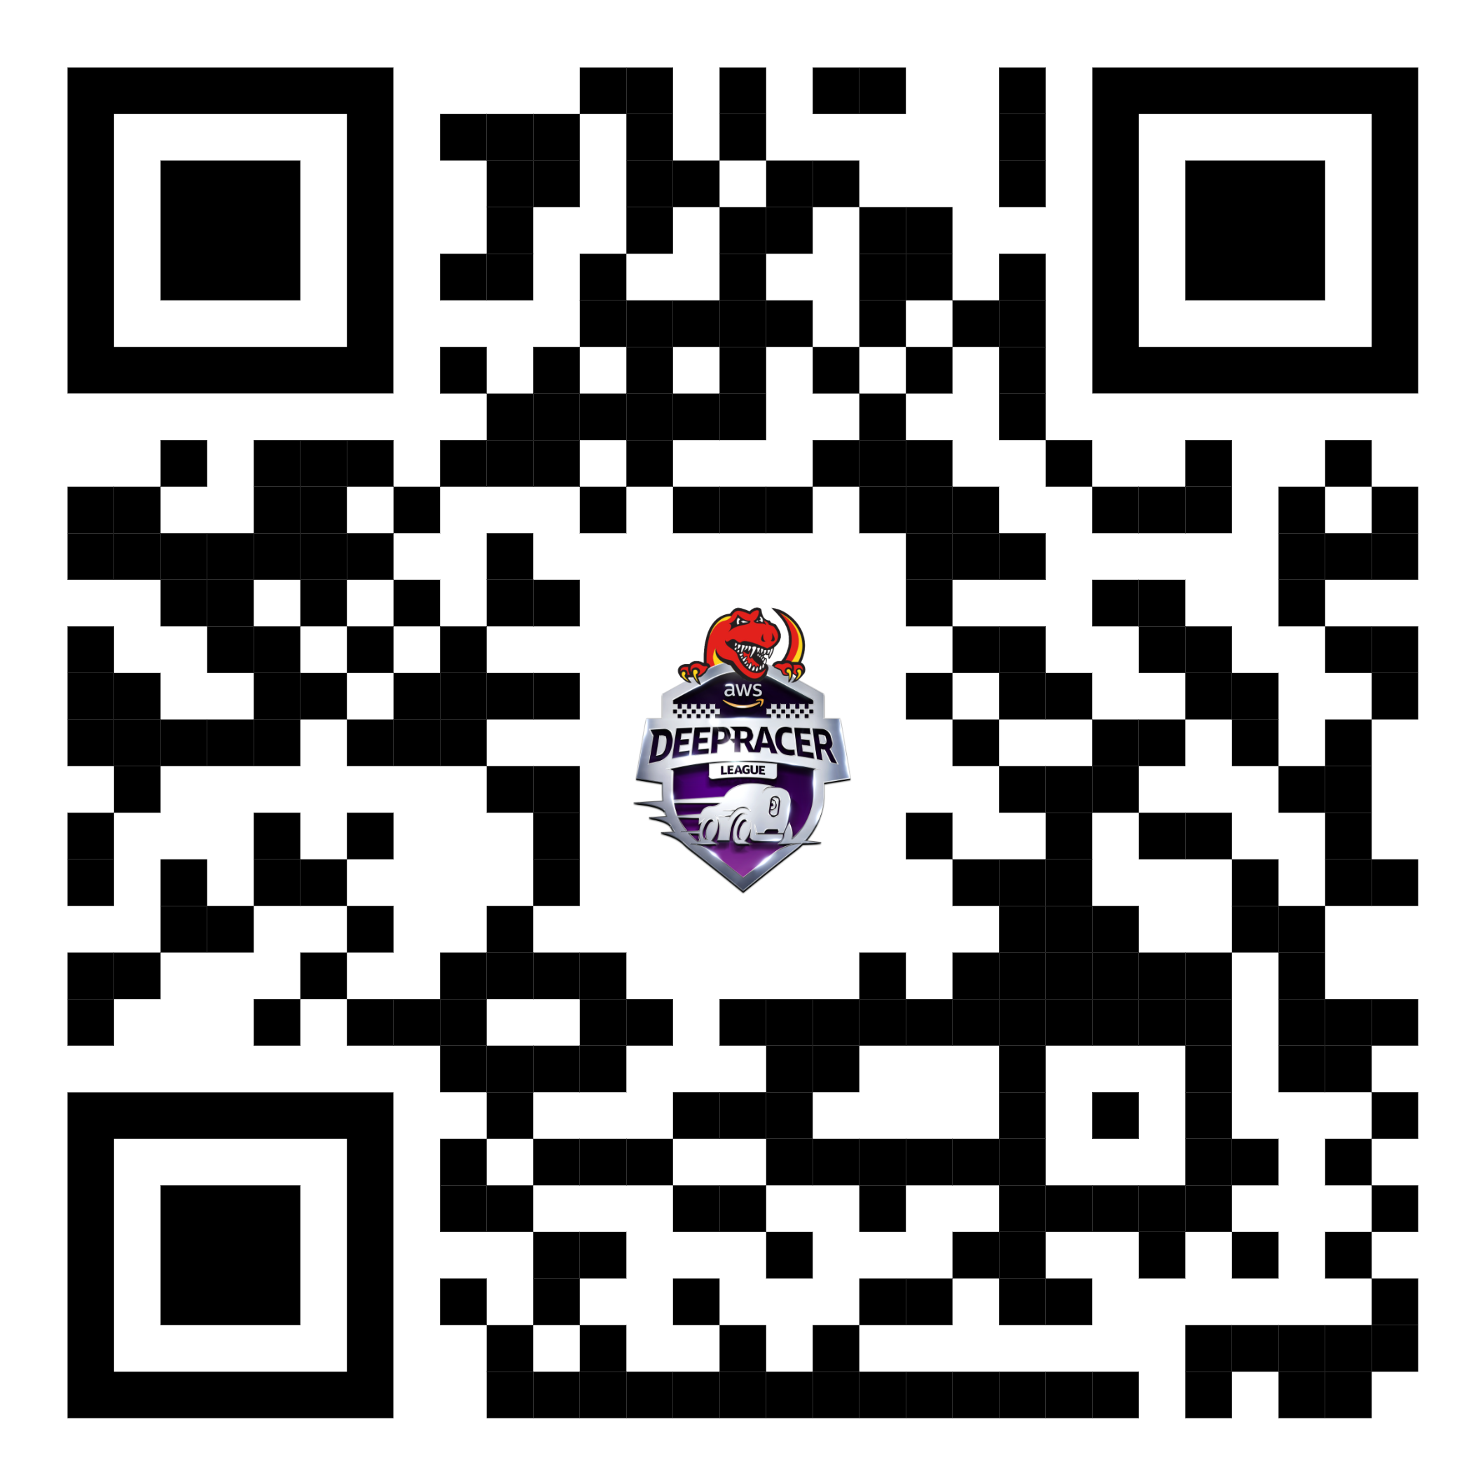
Where to use the online Python Editor
Scan the QR code or head to: https://peen.ca/7t_ij
Or search up:
Programiz Python Online Compiler
Notes:
You can search up Online Python editor, or use the one here: Programiz Python Online Compiler

Slide 8
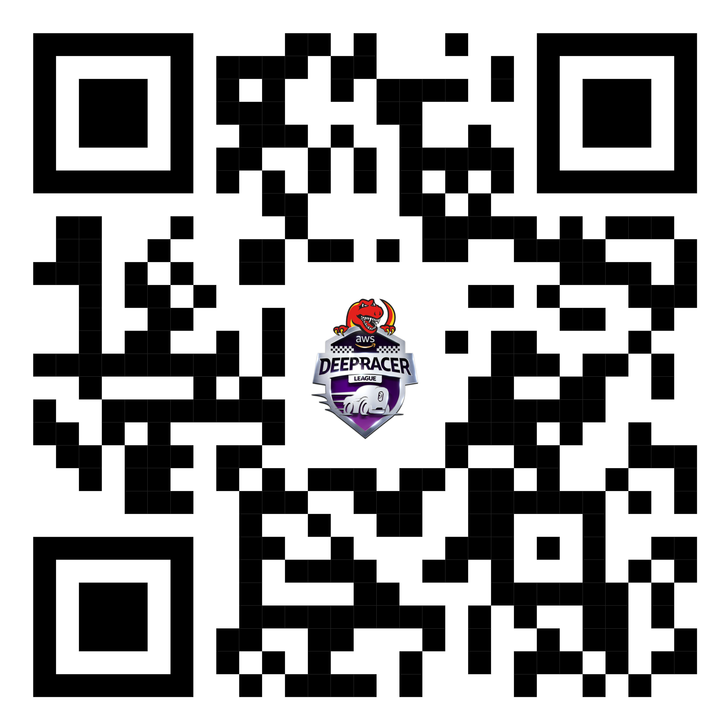
Where to get the notes (HTML)
Scan the QR code or head to: https://peen.ca/o-8un

